Slide 1
Leeds Beckett University
Cloud Computing Development
Dr Anatoliy Gorbenko
E-mail: A.Gorbenko@leedsbeckett.ac.uk Office: CAE118
Kiran Voderhobli
E-mail: k.voderhobli@leedsbeckett.ac.uk Office: CAE228

Slide 2
Cloud Computing Development
Lecture: Fundamentals of Cloud Computing
Anatoliy Gorbenko
Kiran Voderhobli

Slide 3
Lecture Agenda
Definitions
Characteristics
Properties
Intro to Cloud Computing

Slide 4
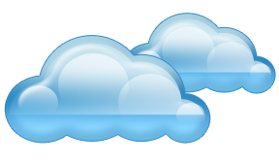
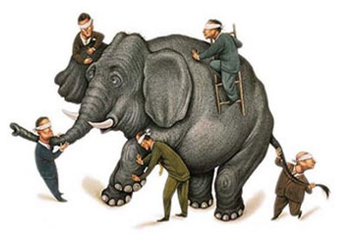
What is Cloud Computing?
Definitions

Slide 5
Cloud Computing Disclaimers
We’ve redefined Cloud Computing to include everything that we already do. I don’t understand what we would do differently other than change the wording of some of our ads.
It's stupidity. It's worse than stupidity: it's a marketing hype campaign. Somebody is saying this is inevitable – and whenever you hear somebody saying that, it's very likely to be a set of businesses campaigning to make it true.
− Larry Ellison (Oracle CEO)
− Rich Stallman (GNU founder)

Slide 6
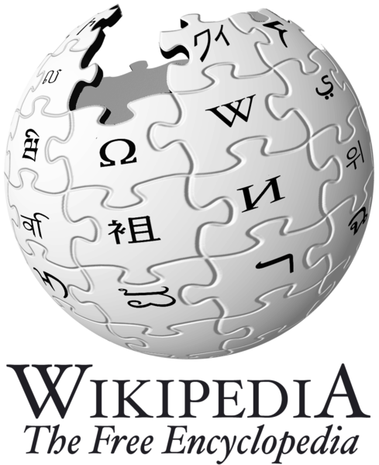

Cloud Computing Definitions
CC refers to both the applications delivered as services over the Internet and the hardware and systems software in the datacenters that provide those services.
The services themselves have long been referred to as Software as a Service (SaaS), so we use that term. The datacenter hardware and software is what we will call a Cloud.
When a Cloud is made available in a pay-as-you-go manner to the public… The service being sold is Utility Computing.
Cloud computing is Internet-based computing, whereby shared resources, software, and information are provided to computers and other devices on demand, like the electricity grid.
Cloud computing is a style of computing in which dynamically scalable and often virtualized resources are provided as a service over the Internet.

Slide 7

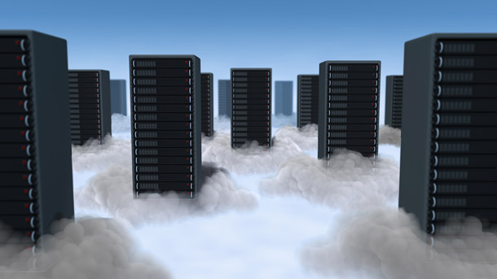
Cloud Computing Definitions
Cloud computing is a model for enabling convenient, on-demand network access to a shared pool of configurable computing resources (e.g., networks, servers, storage, applications, and services) that can be rapidly provisioned and released with minimal management effort or service provider interaction.
This cloud model promotes availability and is composed of (i) five essential characteristics, (ii) three service models, and (iii) four deployment models.

Slide 8
Cloud Computing Definitions
A new paradigm of computing
Central ideas
Utility Computing
SOA (Service Oriented Architecture)
SLA (Service Level Agreement)
Characteristics
On-demand self-service
Broad network access
Resource pooling
Rapid elasticity
Measured service
Enabling techniques
Hardware virtualization
Parallelized and distributed computing
Web services
Properties
High scalability and elasticity
High availability and reliability
High manageability and interoperability
High accessibility and portability
High performance and optimization
Service Models
Infrastructure-as-a-Service (IaaS)
Platform-as-a-Service (PaaS)
Software-as-a-Service (SaaS)
Deployment Models
Public Cloud
Private Cloud
Community Cloud
Hybrid Cloud

Slide 9
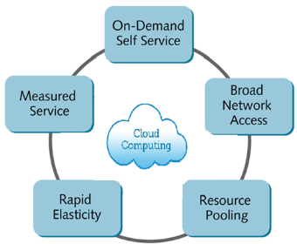
Cloud Computing
Characteristics

Slide 10
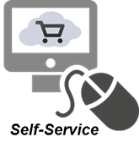
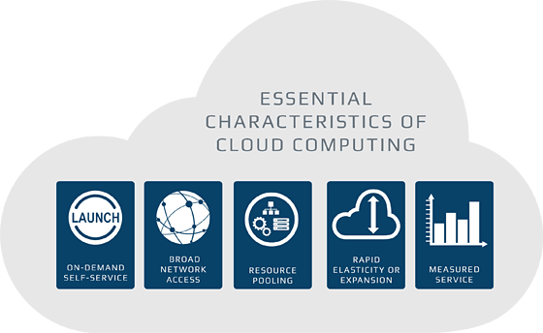
Cloud Computing Characteristics
A consumer can unilaterally provision computing capabilities, such as server time and network storage, as needed automatically without requiring human interaction with each service provider.
On-demand self-service
Broad network access
Resource pooling
Rapid elasticity
Measured service

Slide 11

Cloud Computing Characteristics
Capabilities are available over the network (the Internet) and accessed through standard mechanisms that promote use by heterogeneous thin or thick client platforms (e.g., mobile phones, tablets, laptops and workstations).
On-demand self-service
Broad network access
Resource pooling
Rapid elasticity
Measured service

Slide 12
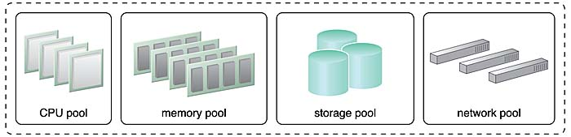
Cloud Computing Characteristics
The provider's computing resources are pooled to serve multiple consumers using a multi-tenant model, with different physical and virtual resources dynamically assigned and reassigned according to consumer demand.
There is a sense of location independence in that the customer generally has no control or knowledge over the exact location of the provided resources but may be able to specify location at a higher level of abstraction (e.g., country, state or datacenter).
Examples of resources include storage, processing, memory and network bandwidth.
On-demand self-service
Broad network access
Resource pooling
Rapid elasticity
Measured service

Slide 13
Cloud Computing Characteristics
The provider's computing resources are pooled to serve multiple consumers using a multi-tenant model, with different physical and virtual resources dynamically assigned and reassigned according to consumer demand.
There is a sense of location independence in that the customer generally has no control or knowledge over the exact location of the provided resources but may be able to specify location at a higher level of abstraction (e.g., country, state or datacenter).
Examples of resources include storage, processing, memory and network bandwidth.
On-demand self-service
Broad network access
Resource pooling
Rapid elasticity
Measured service

Slide 14
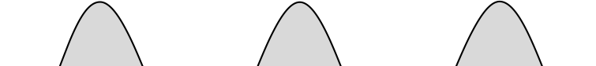
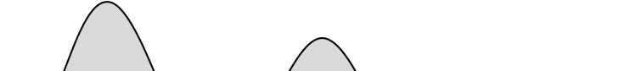
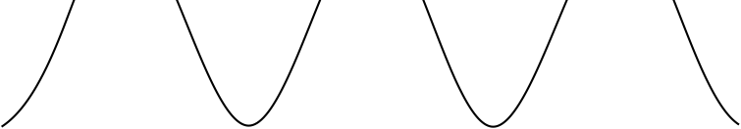

Dynamic Resources Provisioning
2 common problems of on-premises computing
Underestimation of system utilization which results in under provision
Loss Revenue
Loss Users
Resources
Resources
Capacity
Capacity
Demand
Demand
1
2
3
1
2
3

Slide 15
Dynamic Resources Provisioning
Overestimate system utilization which result in low utilization
Capacity
Resources
Unused resources
Demand
Time

Slide 16
Dynamic Resources Provisioning
Cloud resources can be provisioned dynamically
Meet seasonal demand variations
Meet demand variations between different industries
Meet burst demand for some extraordinary events
Capacity
Capacity
Resources
Resources
Demand
Demand
Time
Time

Slide 17
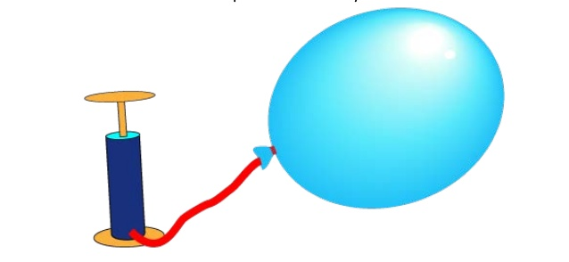
Cloud Computing Characteristics
Capabilities can be elastically provisioned and released, in some cases automatically, to scale rapidly outward and inward commensurate with demand.
To the consumer, the capabilities available for provisioning often appear to be unlimited and can be appropriated in any quantity at any time.
On-demand self-service
Broad network access
Resource pooling
Rapid elasticity
Measured service

Slide 18

Cloud Computing Characteristics
Cloud systems automatically control and optimize resource use by leveraging a metering capability at some level of abstraction appropriate to the type of service (e.g., storage, processing, bandwidth and active user accounts).
Resource usage can be monitored, controlled and reported, providing transparency for the provider and consumer.
Customers pay only for what they actually use (pay-as-you-go)
On-demand self-service
Broad network access
Resource pooling
Rapid elasticity
Measured service

